Slide 1
Partakan Festival 2025
AMAZING RIDE MECHANICS & PRIZES

Slide 2
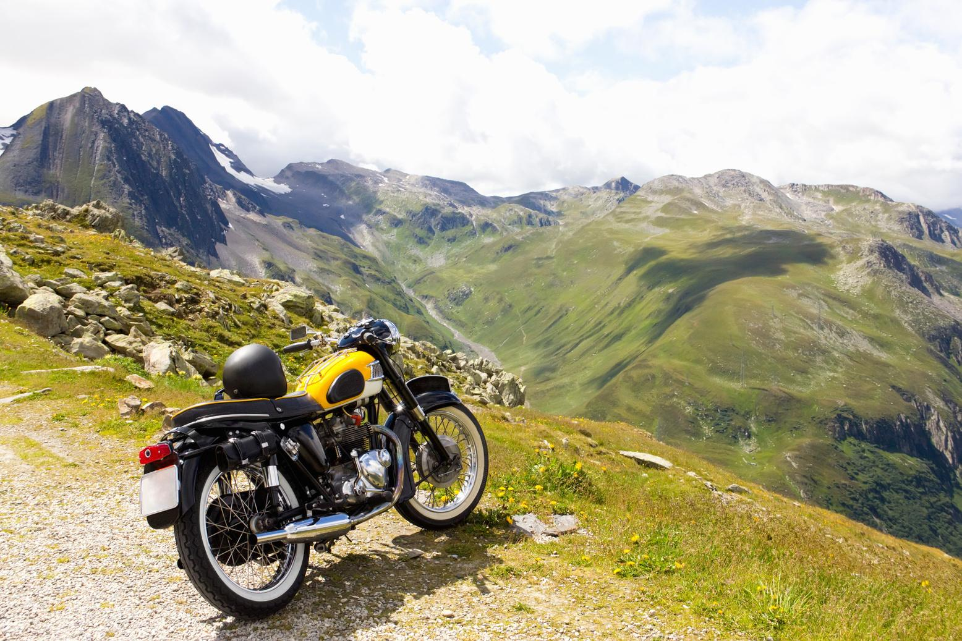
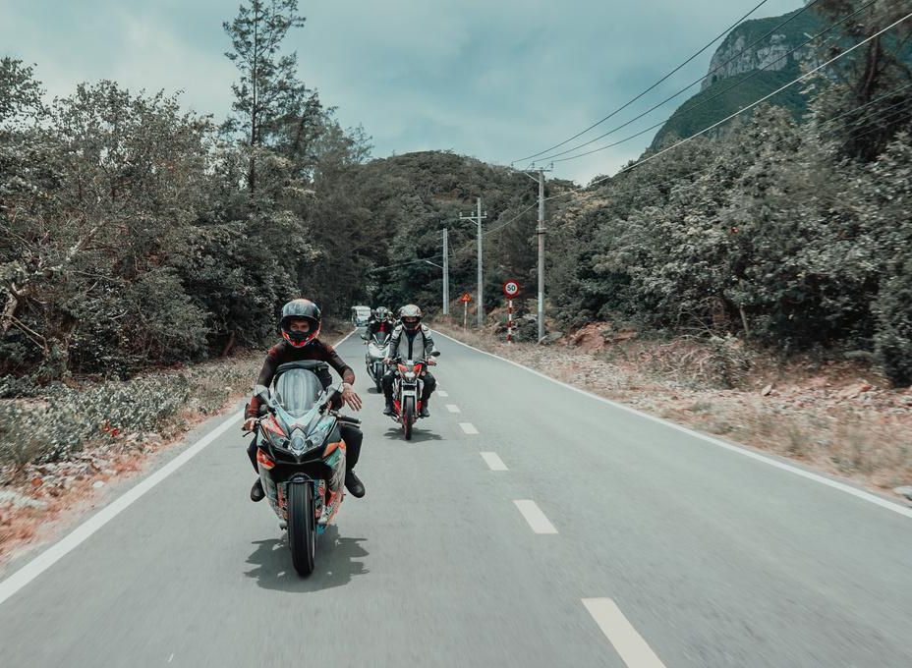
Overview
Over the years, Partakan has been a source of fun, companionship, and adventure to the riding communities. In the past editions, Partakan gathers thousands of motorcycle enthusiasts for a ride to remember bringing their families, friends, and members of motorcycle clubs all over the Philippines.
Motorcycle Tourism
Safety Riding
Camaraderie
Motorcycle Event

Slide 3
Siruma, Camarines Sur
The Batanes of Bicol Region
PARTAKAN FESTIVAL’S NEWEST TOURIST DESTINATION

Slide 4
MECHANICS & ROUTE

Slide 5
MECHANICS AMAZING RIDE:
STARTING POINT: ROPALI CLASSICS ESCRIVA DRIVE, PASIG CITY
RIDERS ROUTE:
MANDATORY CHURCHES
MINOR DE BASILICA OF SAINT MICHAEL ARCHANGEL, TAYABAS, QUEZON
CATHEDRAL OF SAN DIEGO DE ALCALA,GUMACA, QUEZON
PARISH OF SAINT JOHN DE APOSTLE AND EVANGELIST CHURCH, LABO, CAMARINES NORTE
MINOR BASILICA OF OUR LADY OF PENAFRANCIA
METROPOLITAN CATHEDRAL AND PARISH OF ST JOHN EVANGELIST
MANDATORY PIC STOP
ROPALI CLASSICS, ESCRIVA, PASIG
TULAY MALAGONLONG, TAYABAS
ROPALI LUCENA
ATIMONAN MERMAID, ATIMONAN QUEZON
KUTANG SAN DIEGO, GUMACA
ROPALI DAET
SIRUMA HQ/AMAZING RIDE ROPALI BOOTH (LAST CHECKPOINT)

Slide 6
MECHANICS AMAZING RIDE:
STARTING POINT: ROPALI LUCENA, QUEZON
RIDERS ROUTE:
MANDATORY CHURCHES
MINOR DE BASILICA OF SAINT MICHAEL ARCHANGEL, TAYABAS, QUEZON
CATHEDRAL OF SAN DIEGO DE ALCALA,GUMACA, QUEZON
PARISH OF SAINT JOHN DE APOSTLE AND EVANGELIST CHURCH, LABO, CAMARINES NORTE
MINOR BASILICA OF OUR LADY OF PENAFRANCIA
METROPOLITAN CATHEDRAL AND PARISH OF ST JOHN EVANGELIST
MANDATORY PIC STOP
TULAY MALAGONLONG, TAYABAS
ROPALI LUCENA
ATIMONAN MERMAID, ATIMONAN QUEZON
KUTANG SAN DIEGO, GUMACA
ROPALI DAET
SIRUMA HQ/AMAZING RIDE ROPALI BOOTH (LAST CHECKPOINT)

Slide 7
MECHANICS AMAZING RIDE:
STARTING POINT: ROPALI DAET, CAMARINES NORTE
RIDERS ROUTE:
MANDATORY CHURCHES
ST. JOHN THE BAPTIST CHURCH OF DAET
SAINT PETER THE APOSTLE CHURCH - VINZONS
PARISH OF SAINT JOHN DE APOSTLE AND EVANGELIST CHURCH - LABO
PARROQUIA DE NUESTRA SENORA DE CANDELARIA CHURCH - PARACALE
PARISH OF SAINT LUCY AND SHRINE OF JESUS THE BLACK NAZARENE - CAPALONGA
SAINT JOSEPH THE WORKER PARISH CHURCH - MILAOR
METROPOLITAN CATHEDRAL AND PARISH OF ST JOHN EVANGELIST - NAGA
MANDATORY PIC STOP
ROPALI DAET
SIRUMA HQ/AMAZING RIDE ROPALI BOOTH (LAST CHECKPOINT)

Slide 8
MECHANICS AMAZING RIDE:
STARTING POINT: ROPALI DAET, CAMARINES NORTE
MANDATORY PIC STOP
ROPALI DAET
GATEWAY, STA ELENA, GATEWAY TO BICOLANDIA
MALATAP FALLS, LABO
PARISH OF SAINT JOHN THE APOSTLE AND EVANGELIST, LABO
SHRINE OF BLACK NAZARENE OF CAPALONGA, WATCH TOWER
PARROQUIA DE NUESTRA SENORA DE CANDELARIA CHURCH, PARACALE
OUR LADY OF THE MOST HOLY ROSARY CHURCH & JOMAPA SHRINE, JOSE PANGANIBAN
VINZONS SHRINE
ST PETER THE APOSTLE PARISH CHURCH, VINZONS
ANGKO PANDECILLOS, VINZONS
CALAGUAS ISLAND, VINZONS
PRESIDENT CORY AQUINO BOULEVARD
BAGASBAS BEACH, DAET
CATHEDRAL OF THE MOST HOLY TRINITY, DAET
UNANG BANTAYOG NI RIZAL
SAINT JOHN DE BAPTIST CHURCH, DAET
BICOL NATURAL PARK

Slide 9
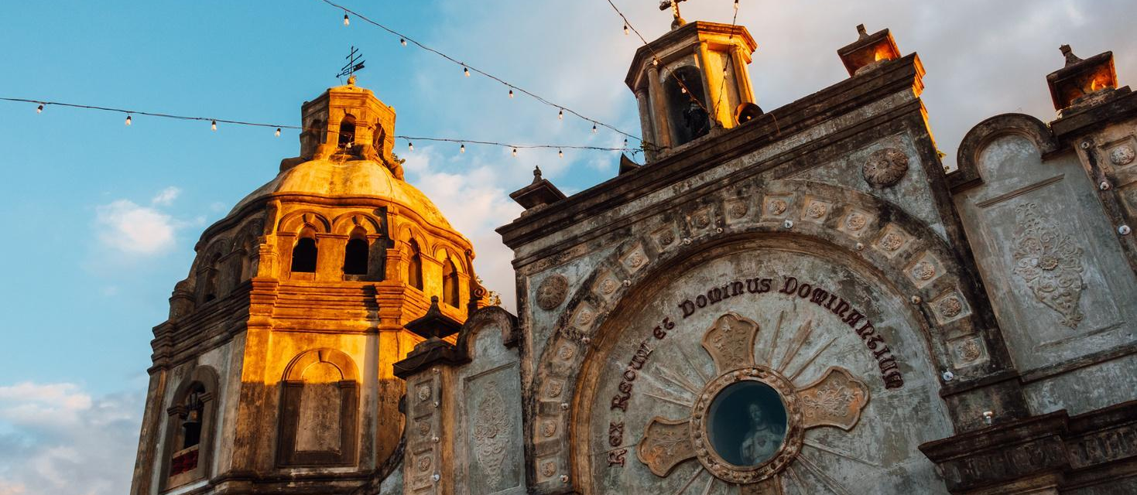
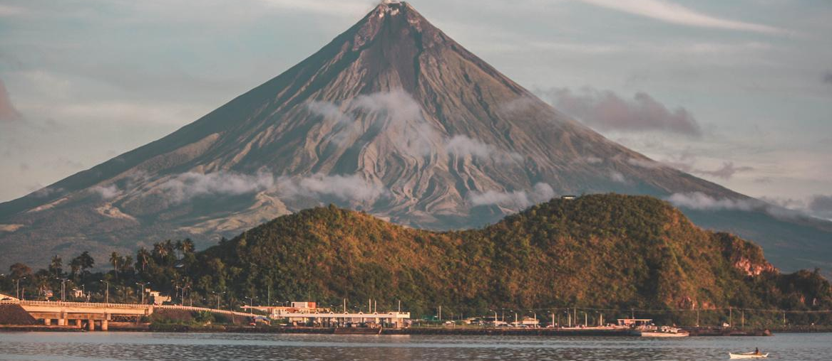
ROPALI MOTORCYCLES
THROTTLE LIFE NEWS
PARTAKAN FEST
THE ULTIMATE RIDE CHALLENGE Content:
VISIT 9 CHURCHES
STOP BY TOURISTS SPOTS
MANDATORY CHECK POINTS CHURCHES
MINOR DE BASILICA OF SAINT MICHAEL ARCHANGEL, TAYABAS, QUEZON
CATHEDRAL OF SAN DIEGO DE ALCALA,GUMACA, QUEZON
PARISH OF SAINT JOHN DE APOSTLE AND EVANGELIST CHURCH, LABO, CAMARINES NORTE
MINOR BASILICA OF OUR LADY OF PENAFRANCIA
Experience the beauty of the journey while completing exciting tasks!

Slide 10
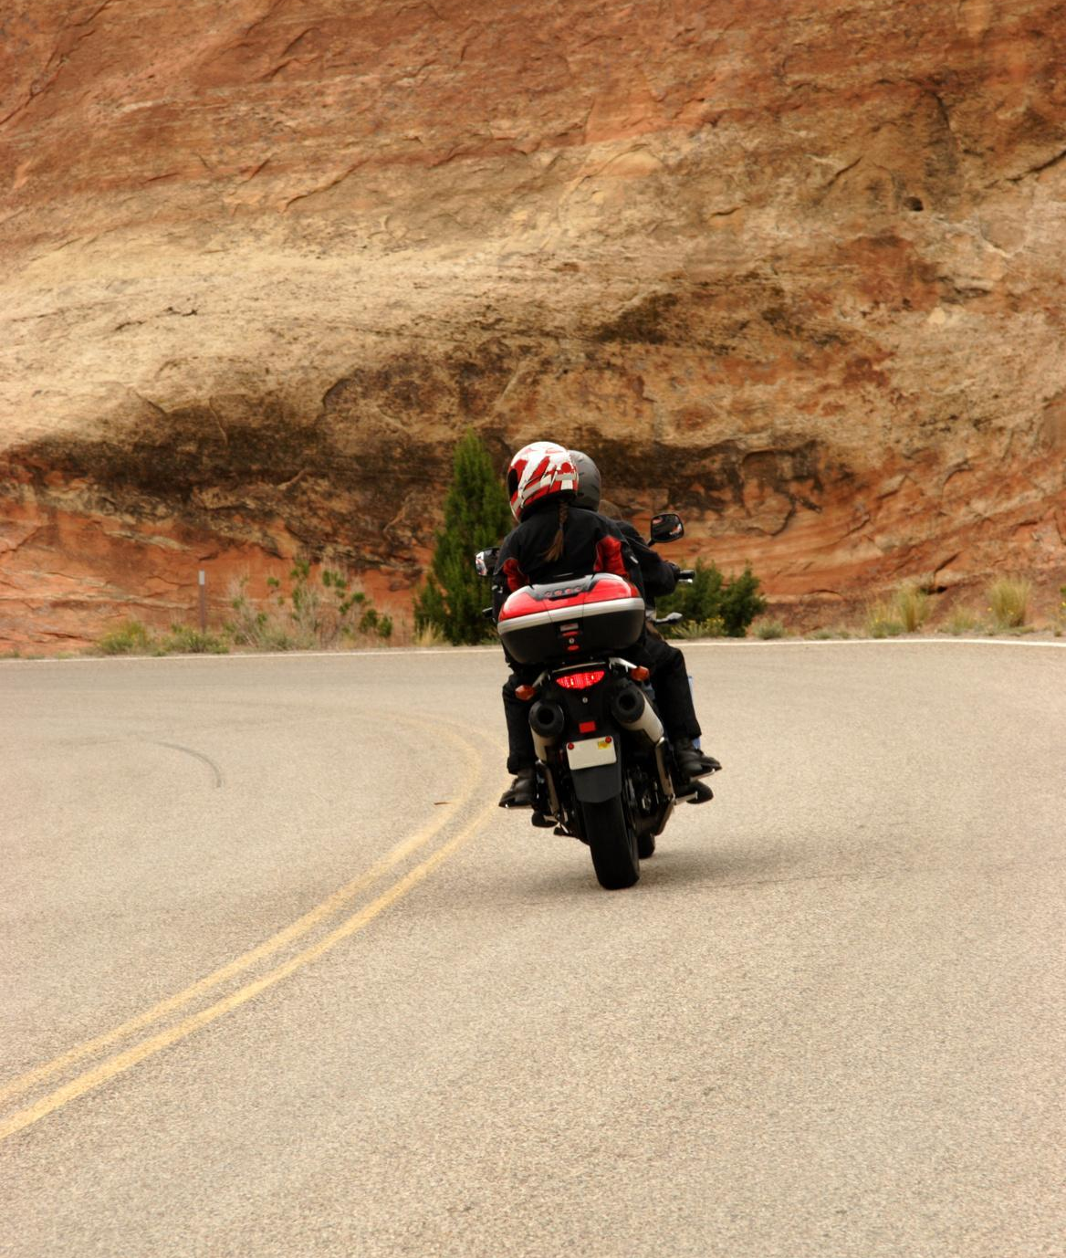
ROPALI MOTORCYCLES
PARTAKAN FEST
CRITERIA FOR JUDGING
01
Completion of required tasks (Church & tourist spot visits)
02
Coverage of Main Event (Saturday activities)
03
Best Story Narrative
04
Best Description of the Photo
Experience the beauty of the journey while completing exciting tasks!
05
Regular HQ Updates
THROTTLE LIFE NEWS

Slide 11
ROPALI MOTORCYCLES
PARTAKAN FEST
CRITERIA:
PHOTO CONTEST
PARTAKAN COMPETITION MECHANICS
• Participants must submit an original photo capturing their Amazing ride or coverage of the event itself.
• Image format should be in JPEG, high resolution.
• No excessive editing or AI-generated content.
• Judging criteria: [e.g., composition, creativity, relevance].
Experience the beauty of the journey while completing exciting tasks!
THROTTLE LIFE NEWS

Slide 12
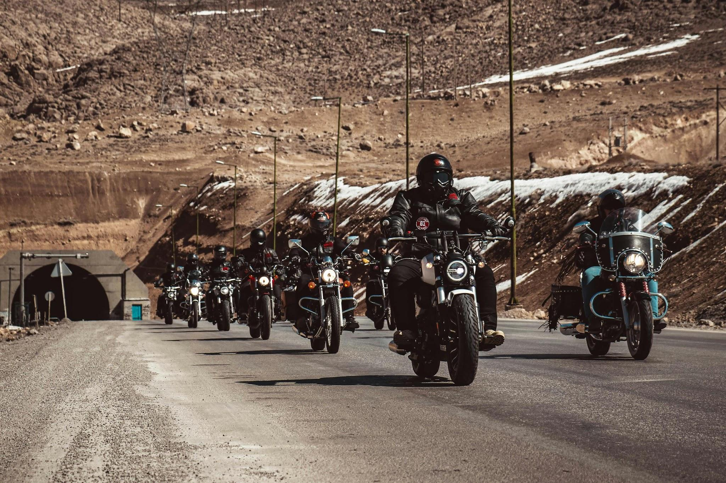
ROPALI MOTORCYCLES
PARTAKAN FEST
CRITERIA:
BEST DOCUMENTARY
PARTAKAN COMPETITION MECHANICS
• Participants must submit an original video showcasing their Amazing ride and coverage of the event itself.
• Minimum duration: 45 minutes.
• Must be in MP4, 1080p resolution.
• Judging criteria: [e.g., creativity, relevance, storytelling, technical quality].
THROTTLE LIFE NEWS

Slide 13
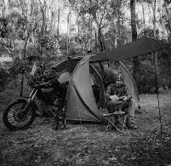
ROPALI MOTORCYCLES
PARTAKAN FEST
CRITERIA:
BEST MOTOCAMPING SETUP
PARTAKAN COMPETITION MECHANICS
• Open to motorcycles manufactured before [year].
• Must be in working condition and provide proof of authenticity.
• Judging criteria: [e.g., originality, maintenance, historical significance].
Celebrate your achievements with the Partakan community!
THROTTLE LIFE NEWS

Slide 14
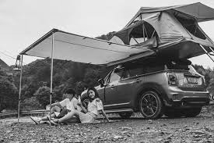
ROPALI MOTORCYCLES
PARTAKAN FEST
CRITERIA:
BEST CARCAMPING SETUP
PARTAKAN COMPETITION MECHANICS
• Open to any 4 wheels
• Must be in working condition and provide proof of authenticity.
• Best Camping Set Up
Celebrate your achievements with the Partakan community!
THROTTLE LIFE NEWS

Slide 15
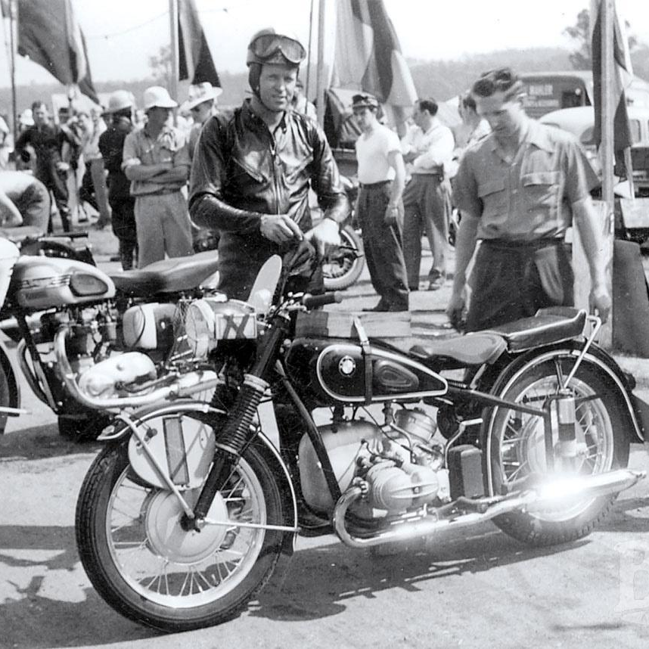
ROPALI MOTORCYCLES
PARTAKAN FEST
CRITERIA:
OLDEST MOTORCYCLE
PARTAKAN COMPETITION MECHANICS
• Open to motorcycles manufactured before [year].
• Must be in working condition and provide proof of authenticity.
•Must present valid OR/CR
Celebrate your achievements with the Partakan community!
THROTTLE LIFE NEWS

Slide 16
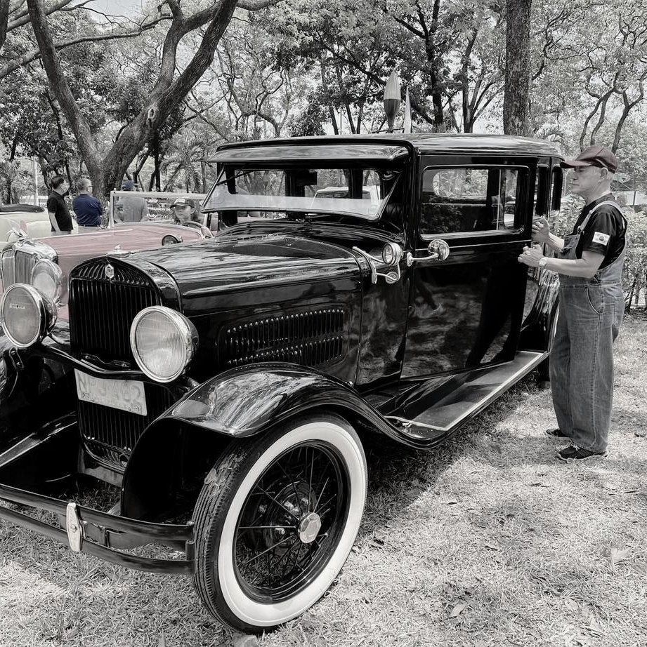
ROPALI MOTORCYCLES
PARTAKAN FEST
CRITERIA:
OLDEST CAR
PARTAKAN COMPETITION MECHANICS
• Open to 4 wheels
• Must be in working condition and provide proof of authenticity.
• MUST PRESENT A VALID OR/CR
Celebrate your achievements with the Partakan community!
THROTTLE LIFE NEWS

Slide 17
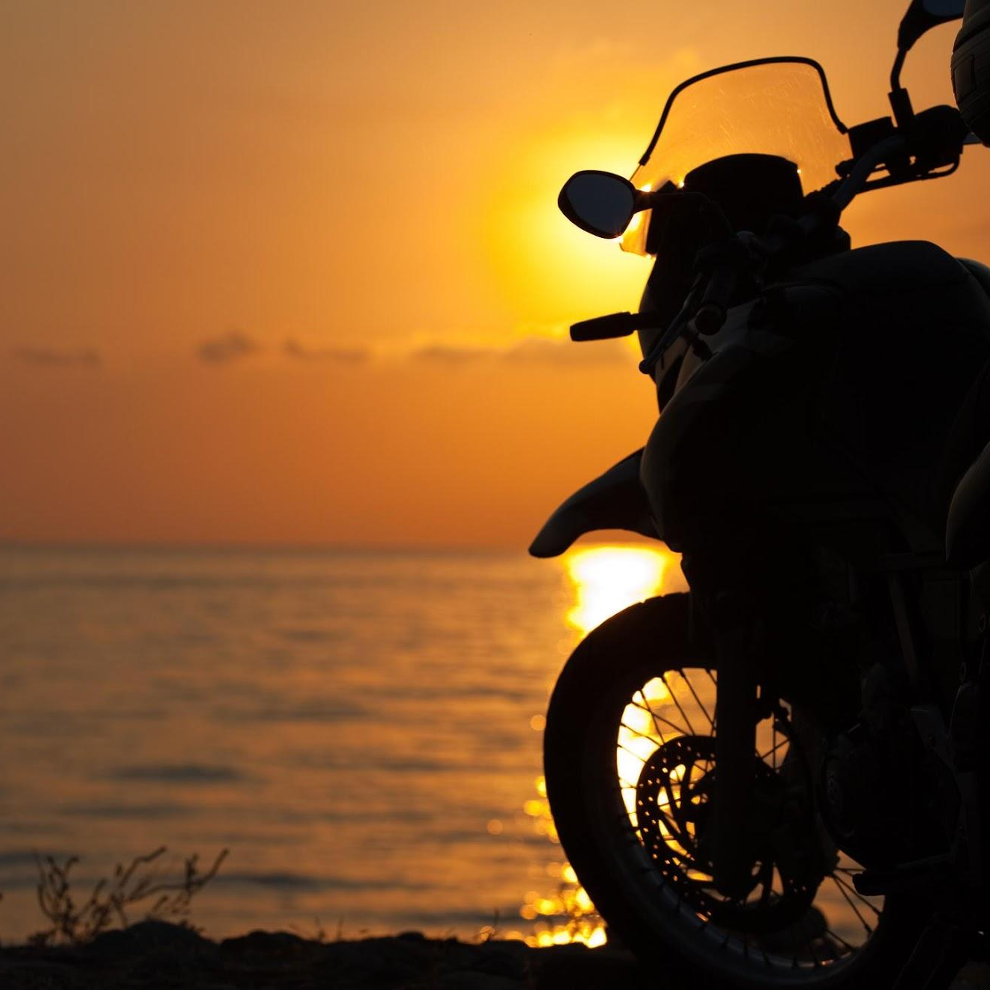
ROPALI MOTORCYCLES
PARTAKAN FEST
BIGGEST DELEGATION
FARTHEST
DELEGATION
Celebrate your achievements with the Partakan community!
THROTTLE LIFE NEWS

Slide 18
ROPALI MOTORCYCLES
PARTAKAN FEST
AMAZING RIDE PRIZES:
BEST PHOTO – P 10,000.00
BEST DOCUMENTARY 1ST PRIZE P 30,000.00
2ND PRIZE P 20,000.00
3RD PRIZE P 10,000.00
BEST CARCAMPING SETUP – P 10,000.00
BEST MOTOCAMPING SETUP – P 10,000.00
OLDEST CAR – P 10,000.00
OLDEST MOTORCYCLE – P 10,000.00
BIGGEST DELEGATION – P 50,000.00
FARTHEST RIDER/DELEGATION – P 20,000.00
Celebrate your achievements with the Partakan community!
THROTTLE LIFE NEWS

Slide 19
Thank You

